Slide 1
The environment and culture of organizations
Chapter 2
Miami Dade College
Sep 7th, 2019

Slide 2
The organization’s environments
Managers should understand the nature of the organization’s environments
Determining the ideal alignment between the environment and the organization
External environment: everything outside the organization’s boundaries that might affect it (general and task)
Internal environment: conditions and forces within the organization
All parts of the environments are not equally important for all organizations
Organizations need to understand the important environmental forces

Slide 3
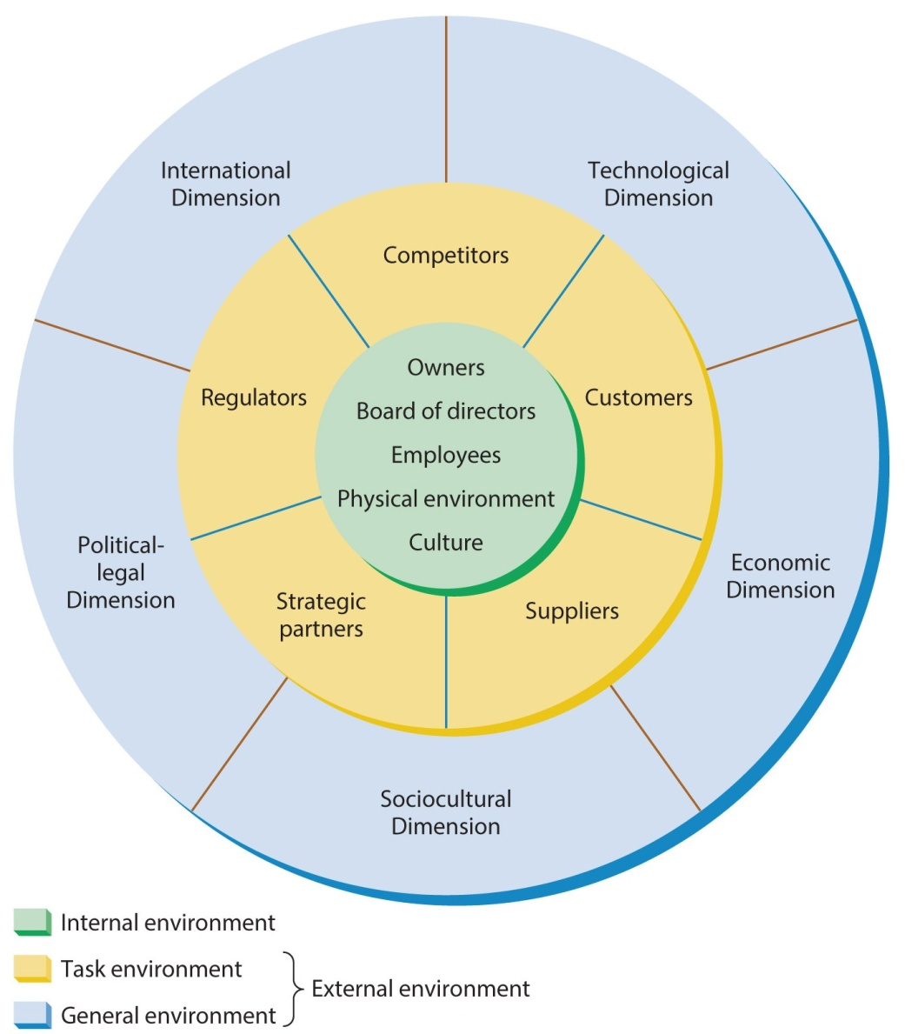
The Organization and Its Environments

Slide 4
The external environment
1. General environment: dimensions and forces that create the overall context
Economic, technological, sociocultural, political-legal and international dimensions
Each of these dimensions has the potential to influence the organization
1.1 The economic dimension: the overall health and vitality of the economic system in which the organization operates
Economic factors: economic growth, inflation, interest rates, and unemployment
- The economic dimension is also important to nonbusiness organizations

Slide 5
Continued…
1.2 The technological dimension:
Methods available for converting resources into products/ services
The forms and availability of technology come from the general environment
The Internet, integrated business software systems,…
1.3 The sociocultural dimension:
Includes the customs, mores, values, and demographic characteristics of the society
Customer tastes, expectations and needs change over time
Appropriate standards of business conduct vary across cultures ( bribing, attitudes in the workforce,…)

Slide 6
Continued…
1.4 The political-legal dimension:
Refers to government regulation of business and the relationship between business and government
It defines what organization can and cannot do
During periods of probusiness sentiment, firms find it easier to compete (fewer antitrust issues)
During periods of antibusiness sentiment, firms find their competitive strategies more restricted (antitrust concerns)
Fewer opportunity for mergers and acquisitions due to anti legislative concerns
Stable/unstable trade relationship with other countries affect doing business

Slide 7
Continued…
1.5 The international dimension:
Organizations are involved or affected by businesses in other countries
The rise of multinational firms
Globalization

Slide 8
Task environment
2. Task environment: specific external organizations/ groups that influence an organization
It includes competitors, customers, suppliers, strategic partners, and regulators
Environmental factors of specific interests to the organization

Slide 9
Continued…
2.1 Competitors: other organizations that compete for resources
Competition can be either direct (competing by selling the same products) or indirect (competing for the same market by selling substitute products)
Businesses compete for quality labor, technology, raw materials, market share…
2.2 Customers: whoever pays money to acquire an organization’s products/services
Dealing with customers, new products/services, new methods of marketing
Adapting to local tastes (product adaptation), preferences and needs as a business expands internationally

Slide 10
Continued…
2.3 Suppliers: providing resources for other organizations
A business should try to avoid depending exclusively on particular suppliers
They might raise the prices, be shut down or go out of business
Building ties with major suppliers for mutual benefits
2.4 Strategic partners: two or more companies work together in joint ventures or other partnerships
It helps companies get from other companies the expertise they lack
2. 5 Regulators: the elements that have the potential to control, legislate or influence an organization policies and practices

Slide 11
Continued…
Regulatory agencies: created by the government to protect the public from certain business practices or organizations from one another
Such as: Environmental Protection Agency (EPA), Food and Drug Administration (FDA), …
Interest groups: organized by their members to attempt to influence organizations
Such as: National Organization for Women (NOW), Mothers Against Drunk Driving (MADD),…
They can exert influence by using the media to call attention to their positions

Slide 12
The internal environment
It consists of owners, board of directors, employees, physical work environments and cultures
Owners: people who have legal property rights to the business
Individual who establishes and runs a small business
Partners who jointly own the business
Individual investors who buy stock in a corporation
2. Board of directors:
Elected by stockholders
Overseeing the general management of the firm to ensure it is in line with stockholders’ interests
The board hires/fires the top officers

Slide 13
Continued…
3. Employees:
Diverse employees in terms of gender, ethnicity, culture, age, ability,…
Calling for job ownership in the company
Increased reliance on temporary workers
Employee-management issues (labor union)
4. Physical work environment:
Employee safety and health regulations
Working conditions and settings
Interaction between people and machines

Slide 14
Continued…
5. Organizational culture:
The set of values, beliefs, customs, behaviors, attitudes
It stems from the organization’s founder
How to do things? What practices are important
Ranging from formal settings with rigid work rules to fun and excitement
It can shape overall effectiveness and long-term success
Managers should understand the culture and decide to keep or change it
Culture problems arise from mergers when the cultures of firms are so different

Slide 15
Effects of environments on organizations
Environmental change and complexity:
Two dimensions: degree of change and degree of homogeneity
Degree of homogeneity: environment is relatively simple or complex
Degree of change: environment is relatively stable or dynamic
Interaction between two dimensions determines the level of uncertainty
Organizations with stable and simple environments: the least uncertainty (subway)
Organizations with dynamic but simple environment: the moderate uncertainty (clothing manufacturing)

Slide 16
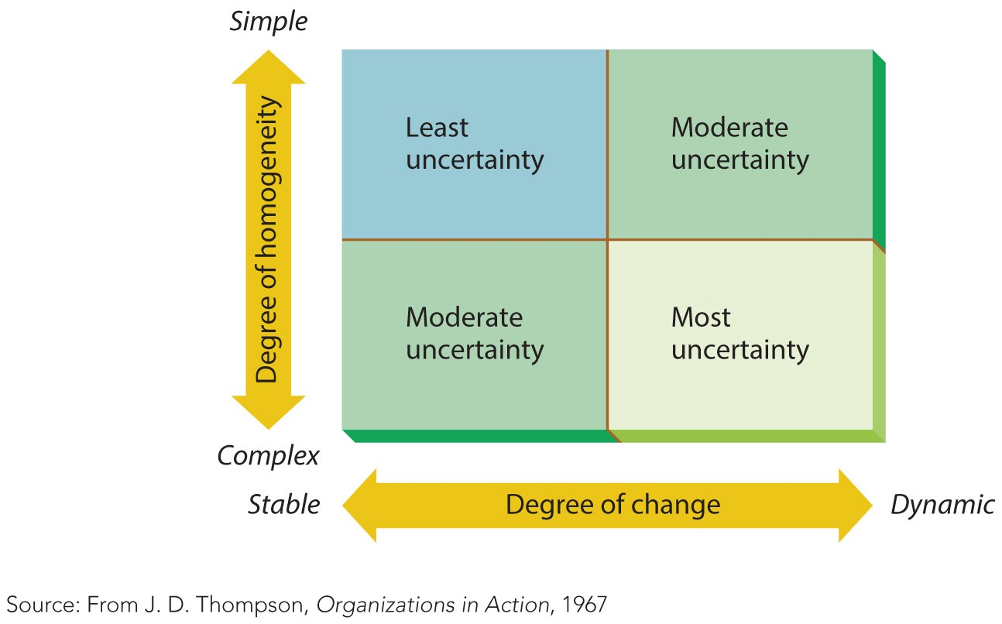
Continued…
Organizations with stable but complex environments: the moderate uncertainty (Ford)
Organizations with dynamic and complex environments: the most uncertainty (Apple)

Slide 17
Continued…
2. Competitive forces (5 forces):
The threat of new entrants: new competitors can easily enter a market (capital)
Competitive rivalry: competitive relationship between dominant firms in the industry
The threat of substitute products: availability of alternative products
The power of buyers: the ability to influence suppliers
The power of suppliers: the ability to influence potential buyers

Slide 18
Continued…
3. Environmental turbulence:
Environmental change with no warning
Crisis is the most common form of turbulence (crisis team)
Workplace violence
Example: The Travel industry
Now, how organizations adapt to the environments?
Information management: monitoring the environments for signs of change, environmental scanning
Strategic response: more investment, cutting back, expanding into international market…
Mergers, acquisitions and alliances:

Slide 19
Continued…
Merger: two or more firms combine to form a new firm
Acquisition: when one firm buys another
Alliance: A partnership in which two or more companies are joining to undertake a major project (enter into new markets)
4. Organization design and flexibility: few standard operating procedures
5. Direct influence: long-term contract with suppliers, finding new customers, lobbying and bargaining

Slide 20
Models of organizational effectiveness
Systems resource approach: organization can acquire the resources it needs (inputs)
Internal process approach: internal mechanisms, efficient operations, managing resources properly (transformation processes)
Goal approach: the degree to which an organization reaches its goals (outputs)
Strategic constituencies approach: satisfying the strategic constituents in the environment (feedback)
Integrated perspective (unifying model): inputs+ transformation processes+ outputs+ feedback

Slide 21
The first individual assignment
Choose a company (any fields)
Analyze the effects of environment on the company based on the following three ways:
Level of uncertainty (evaluate the company’s environment by looking at its complexity and change dimensions)
Competitive forces (analyze the industry in which the company operates according to the 5 forces)
Environmental turbulence (is it a turbulent market? Why?)
What have been the organization’s actions to adapt to the environmental factors? (name and explain some strategies used by the company)
Min 3 pages
Submission deadline: Sep 14th,2019

